Slide 1
Stock Analyser with live data
Pratham Kakkad (200050131023)
Jaydeep Sharma (200050131024)

Slide 2
Description
This project analyses the stocks on a live basis.
It analyses the stocks considering the deepest analyzing points that pro traders use.
The analysis of the stocks is done here in two ways.
We thought of giving the option to the user to decide whether they have to analyze the stock on daily basis or if they want it for their intraday trading.

Slide 3
1. PIVOT POINT calculations.
For a daily basis, we used the PIVOT POINT calculations.
If the stock opens above the pivot point, it is predicted that there is an 80% chance that the selected stock will show an uptrend.
And if the stock opens above the pivot point, it is predicted that there is an 80% chance that the selected stock will show a downtrend.
There are various kinds of Pivot Points, but for instance, we considered:
1. Standard Pivot Point.
2. Woodie Pivot Point.

Slide 4
2. Intraday Analysis
For Intraday, we used the previous minute candle closing percent analysis.
Traders analyze the candles of the stocks thoroughly for their intraday session, one of the trends is to check the last-minute closing change percent for taking the next step for their intraday.
This will show the changing percent, and if the stock crosses the decided changing percent, then the code will notify the user on the user’s WhatsApp number. (default it is selected as 0.0004%)

Slide 5
Dataset References
1. Finnhub
https://finnhub.io/docs/api/stock-candles
Finnhub provides its module which we need to install and has a lot of functionalities to use the real-time stock market data for analysis.
2. ALPHA VANTAGE
https://www.alphavantage.co/documentation/
ALPHA VANTAGE provides its module which has a lot of libraries and particularly we imported alpha_vantage time-series i.e. Timeseries. We used it for intraday real-time data.
3. Dailypik
https://dailypik.com/best-us-stocks/
Referring to the above site, we created a local excel sheet which we later converted into DataFrame and used in the program. And we created this excel sheet out of this :
https://github.com/pratham180702/python_live_Stock_analysis/blob/main/stock_list.xlsx

Slide 6
Results

Slide 7
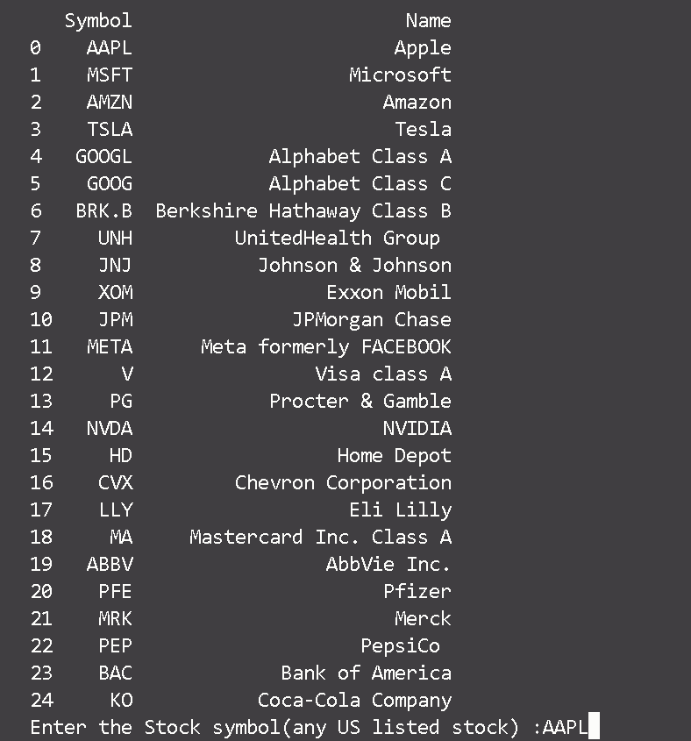
Initial Selections
Here the user will select the stock’s symbol
whichever Analysis one has to do.
Here I’ve selected AAPL which stands for
APPLE INC.

Slide 8

Daily Pivot Point Analysis
Next option will be the selection between the daily and intraday last candle closing percent
change analysis.
Here I’ve selected ‘1’ as I wanted to analyze the pivot point of AAPL stock.

Slide 9
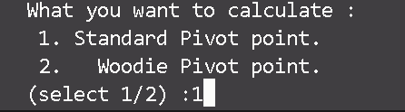
i) Standard Pivot Point
As there are many kinds of Pivot Points available in the Market, our tool gives us the option
to choose whichever we want.
Here I’ve selected ‘1’ for ‘Standard Pivot Point’ calculation.

Slide 10
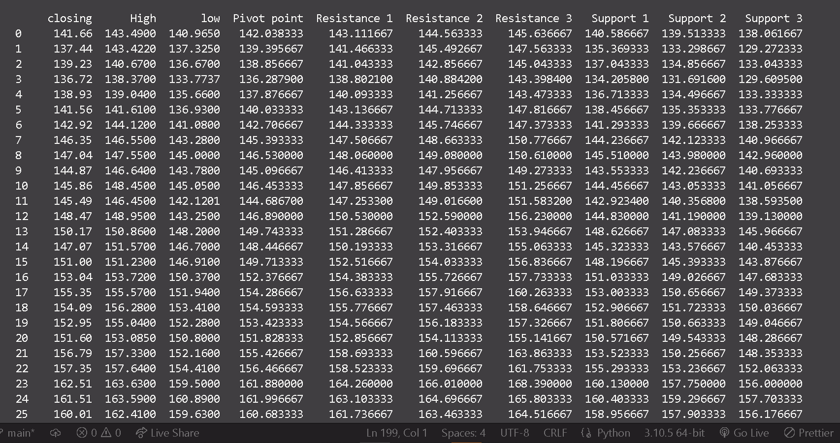
Cont.
First it will show all the data from the past one year

Slide 11
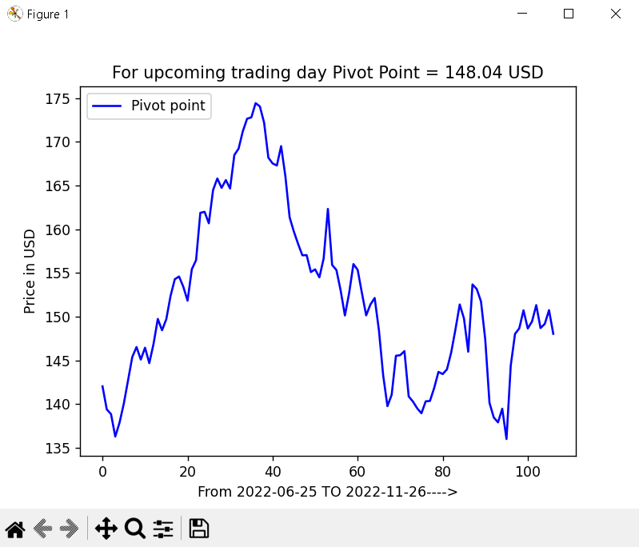
Cont.
Then it shows all the pivot points curve from the past year. And the latest upcoming trading day Pivot Point.
Here for selected stock i.e. Apple Inc., the pivot point of the upcoming trading session is 148.04 USD

Slide 12
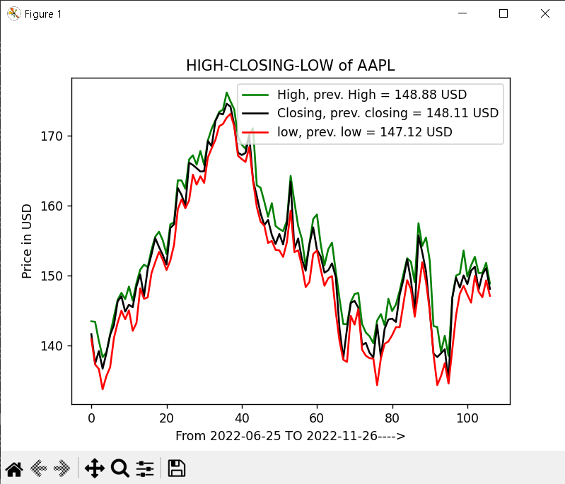
Cont.
Then it shows the HIGH-CLOSE-LOW curve from the past year.

Slide 13
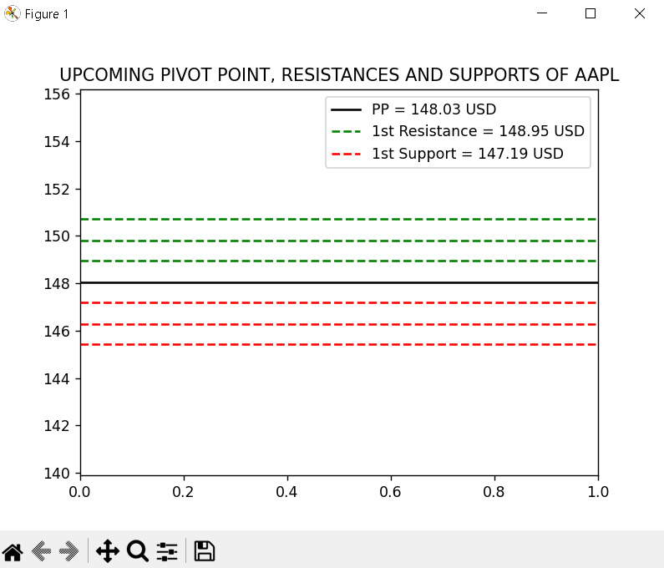
Cont.
Then it finally shows the horizontal line graph of the Pivot Point with three resistances and three supports.
Here,
Pivot Point = 148.03 USD
Resistance 1 = 148.95 USD
Support 1 = 147.19 USD

Slide 14
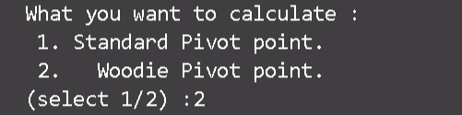
ii) Woodie Pivot Point
What if the user had selected ‘Woodie Pivot Point’ instead of the Standard one in slide 9?
Standard Pivot point and Woodie Pivot point is almost the same, the only difference is
Woodie Pivot point calculation sees the prev. closing, high, and low in a different baseline
way and is almost near the standard pivot point.
The Woodie Pivot Point will come out to 148.06 USD.
Resistances and Supports will change a little but the representations will be the same as we
saw in Standard Pivot Point.

Slide 15
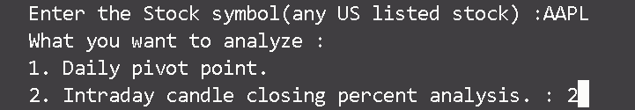
Intraday Analysis
For the Intraday candle closing percent analysis, the user should select ‘2’ instead of ‘1’ in
slide no. 8.

Slide 16
Cont.
Then the tool will ask the user to enter the phone number, So that whenever the changing
percent crosses the alert limit percent the tool will notify the user on WhatsApp
as an autogenerated notification.

Slide 17
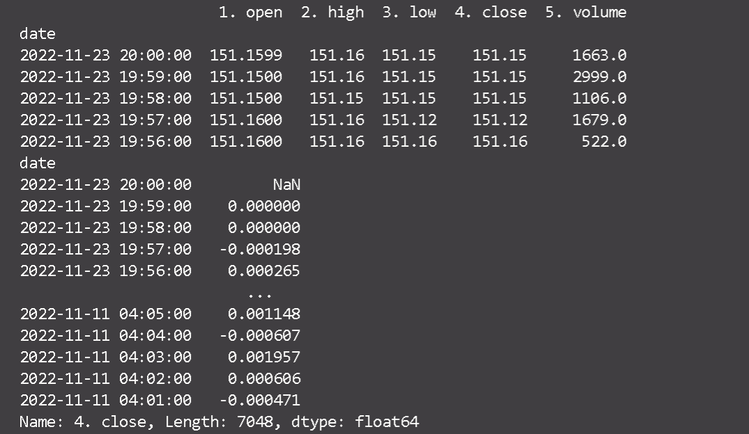
Cont.
Then the tool shows the general values of intraday with the closing change percent of the last-minute candle to the user.

Slide 18
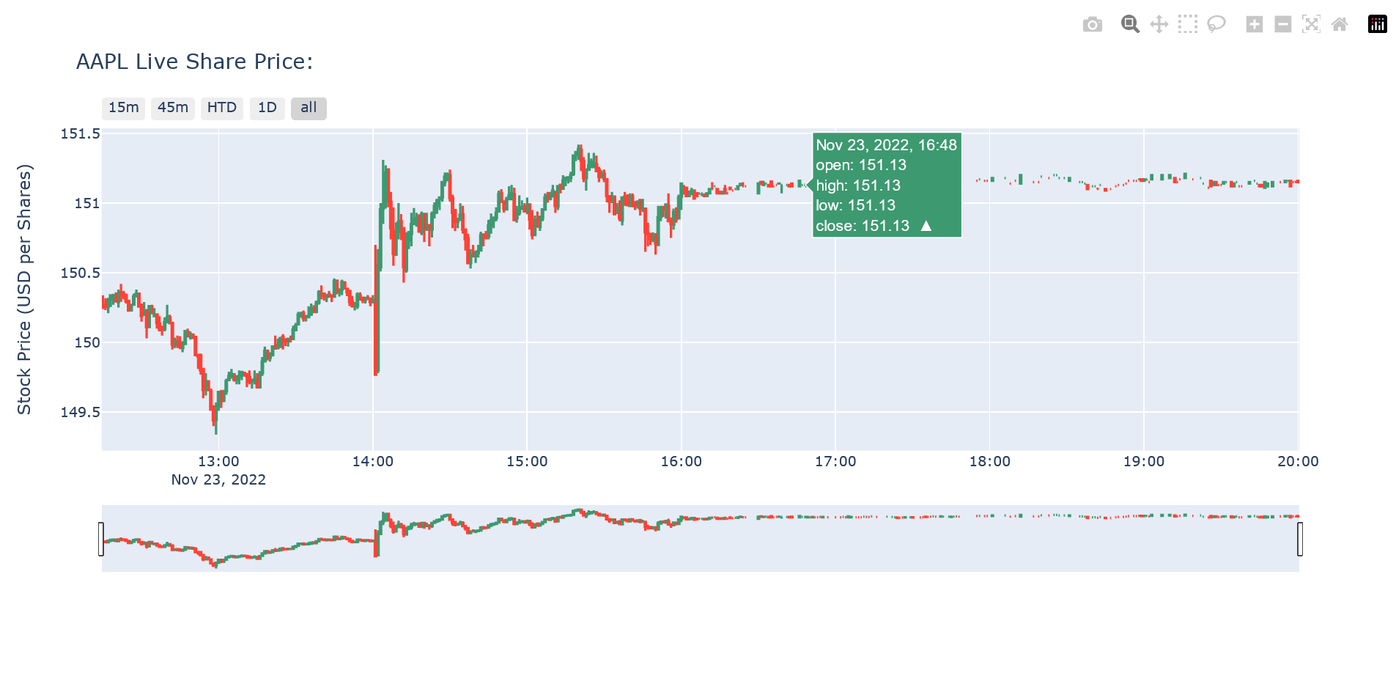
Cont.
Then the tool shows the intra-day candle of the selected stock to the user. (Here the selected stock is Apple Inc.)

Slide 19

Cont.
And finally, if the stock last minute candle closing percent crosses the limit changing percent, the tool notifies the user on WhatsApp on the number user entered earlier.
Here the change percent was -0.0004711%.

Slide 20
Conclusion
Stock analysis is one of the most important tools to move forward in the flow with the fluctuation of the stock market and Data Science helps to analyze the Stock market in a better way.
Python with its libraries provides many tools and functions to work with a large quantity of data very easily.
Python makes Stock analysis and data analysis easy and helps many users/noncoders to take beneficial decisions.

